Slide 1
The new world of professional management…leading with intention, managing with evidence.
Missy Armstrong, MS, CTRS/R, FDRT
Please don’t be afraid to make mistakes just make different mistakes

Slide 2
Objectives
Identify at least 4 evidence based skill sets required for a manager in any setting; professionalism, communication, measured competency; feedback with purpose.
Demonstrated ability to integrate data to improve productivity, effectiveness and cost analysis
Identification of at least 3 evidence based requirements of a well managed program in any setting; goal setting, data management, staff recognition, hiring and maintaining quality staff.

Slide 3
Being a leader in health care is like constantly walking up a down elevator…
Strategic step in my future
Because I can
More money, honor, prestige
Pushing the boundaries of my profession
Passion, persistence
Expand RT/TR reach
Notes:
I am indispensable 10
I enjoy my role but I am not indispensable 5
I’m interim and do not provide critical insight 3
I hate this stuff but I want to keep my job

Slide 4
Leadership Principles
Alignment with mission/vision/values
Communication
Recognition
Challenging, respecting and facilitating process
Empowering others…selecting through capability, responsibility and delegated authority.
Accountability
Applying the process
Resolving conflict
Applying data to decision making
Notes:
Leadership is the accountability of getting others to move in the same direction. It is not about personality; its’ about practice

Slide 5
EBP Core standards
Researched
Relevant
Objective measurement/data including budget
Established standards of treatment
Safety/competency
Communication
Recognition
Resiliency
Ethics
Notes:
Health Care Finance
Beyond the Checklist

Slide 6
What skill sets of a TR transfer to management?
Communication
Facilitation
Understanding human behavior
Clinical Reasoning/Rationale
Creative program development
Goal setting for therapeutic purpose

Slide 7
Chickens are involved in building a breakfast but pigs are committed.
Are you peripherally involved in your team, discipline, division, community?
OR
Are you committed to making a difference in all of the above?

Slide 8
Advocacy
Budget
Clinical competency
Program management
Team Building
Personnel

Slide 9
Advocating for the profession
Language used in the IP setting must be in terms of function, wellness and quality of life should dominant OP and community health
Must contribute to the well being of the client in objective measures
General happiness and well being while valued aren’t going to be paid for
RT has interventions as viable options that we have to advertise, educate our referral base and inform health care users
Protection from outside credentialing organizations i.e. JC and CARF does not guarantee inclusion in the interdisciplinary team

Slide 10
(Budget/Accountability)
Define what data you currently generate that supports the service
Develop what you need generally focusing on better care and lower costs if in a 24/7 organization
Develop what you need generally focusing on better health and lower costs if NOT in a 24/7 organization
Talk with the organizations financial and quality personnel to gain perspective

Slide 11
Presentation is the first “gift” of professionalism: Communication
The 4 No “B’s”
Interdisciplinary team respect and behavior
Clarity in communication, concise, objective information
Knowledge and competency to include safety
Ethical Standards
Notes:
Rogers an OT says that there are three transitions in a career
Non-professional or student to professional (clinician)
Generalist (clinician) to specialist (senior clinician)
Specialist to professor or teacher/mentor
She also advocates for adding a fourth which would be clinician to manager
What do you think is the worst transition.
No butts, no back, no belly, no boobs.
Professional clothes:
Old joke about rehab therapists…..the PT’s are always in khaki, the OT’s always wear skirts, the Speech folk always have a scarf around their neck, and RT’s always look as if they have just gotten out of the pool.
Part of a team---no more or less equal than the sum of the parts. As part of our interview process the management team asks the question; what experience have you had working with OT-PT-SP-TR. Often the answer is that the rehab therapies are OT/PT/SP----TR works on the other side of the building or they do activities.
Behaviors demonstrate understanding of what we can offer, our knowledge and skill base, and the ethics of our programming.

Slide 12
3 ‘B’s or 3 ‘O’s
3 ‘B’s
Bingo
Bible
Birthday
3 ‘0’s
Options
Opportunities
Outcomes

Slide 13
Examples:
Participated in Bingo……smiled and expressed pleasure at activity
Demonstrated fine motor coordination in relevant personally chosen activity.

Slide 14
Division/Discipline Goal Setting
Clear and communally agreed on; data standard, productivity, cost containment
Aligns with department and facility goals.
Personal employee goals
Agreed on data points
Are determined after analysis of existing data.
Staying ahead of the newest information
National, regional, state
Relevance to your setting but with an eye to other settings
Analyzed at least annually with a focus

Slide 15
National Outcomes of IRF’s
Reduced LOS
Support to other disciplines
30 day readmission
Tracking
Infection control
Notes:
If you don’t think you should have goals in these arena’s you are very very wrong.

Slide 16
Formulary for FTE/Productivity
1 FTE = 2080 work hours per year
Minus benefit time i.e. vacation, cont. edu, sick
Total work hours minus benefit time divided by 12 months = percentage of potential productive time.
1 FTE = 2080 hours per year
Minus 80 hours sick, 80 hours (+/-) vacation, continuing education (60 hours)=220
2080-220= 1860/12 months = 155 hrs. per month (51%-58%/80 or 90 hours)

Slide 17
Productivity Levels
Established productivity based on Clinical levels: Level I, II, Supervisor
Units of service per employee, per consumer……tracked over longer periods of time
Face to face contacts only; rounds, program development are necessary but do not count for levels of service.
Notes:
Entry level I, II, Supervisor or Clinical Specialist
Knowing what the standards for your facility are is critical.
Establish the standard, make it realistic, track over

Slide 18
Cost Assessment
Overhead to the facility
-Square footage of space dedicated to RT
Salary/Benefit packages including continuing education
Equipment costs; Van to include maintenance, risk, insurance, depreciation
Administrative Support
General equipment and program costs

Slide 19
Hiring the best!
Determine the clinical need
Determine the personality need
Select the hiring committee
Structure the interview to include face to face, clinicians and managers, and a written clinical test.
Score the results
Bring the group back together to discuss candidates
Notes:
Before the hiring is completed be sure that the new employee knows the rules; limits to vacation times, personnel rules that may cause ire later…..

Slide 20
Wise words………..
It is rare for a credentialed employee to be “let go” for competency although it is the easiest to prove. It is most difficult to let go of someone whose personality doesn’t meet a need or fit a team. The time and energy required at hiring is worth it………..to get the best………..and saves the time required later to have them leave.
Notes:
If you counsel the low performer and change the behavior everyone wins.
If you can’t change the behavior then counsel out the door.

Slide 21
Clinical Competency
Diagnosis and/or population specific
Unique and relevant to our practice, within scope and validated by job analysis
Identifies clinical risk/safety concerns
Can be demonstrated/tested
Include annual high risk testing
Professional competency; interdisciplinary commonalities
Notes:
Stroke, SCI, amputation, Traumatic Brain Injury, ADA, Clinical Reasoning, Community standards,
See one, do one, teach one.
Think through the process of accreditation……competency are based on discovery

Slide 22
Builder-Brown
Bottom line….law abiding….structured….enjoy leading….wants justice, has deep respect for traditions….are parental by nature. Believe in preparation, saving and having a family foundation. Strong willed, organized, get the job done……data driven….can build within a structure as long as structure is known.
May appear to tred on toes

Slide 23
Relator-Blue
Enjoy people and have a high regard for emotions….will bend needs for others…judgment on people then with facts….sympathy/harmony…brotherly love…strong expressed emotions…invested in not making data decisions…exterior detail….team work, group projects….
Feelings are more important than data, difficult to change

Slide 24
Planner - Green
Planning for new and better…..details count….want competency and perfection, respect knowledge, and are a thinker….expect life to proceed logically…….person of reason and wisdom…..can imagine…..values the inner experience……creative
Can’t complete projects, can be stuck to detail

Slide 25
Adventurer - Red
Enjoy being where the action is….best in crisis…believe that people are free and are not bound by rules...light hearted..quick..enjoy danger…the present is the most important, yesterday is not important and tomorrow not yet relevant...imagination...good time...stir the blood..thrill management..bounty of ideas…fun….change….challenge.
Difficult to rein in, suggest rules are for others,

Slide 26
Before signing on the dotted line
the reality of the job at hire: schedule, vacation rules,
their own working data
the potential personal growth through continuing education, clinical competency and job potential
they have the support of the manager
what continuing education will be available
that individuals who aren’t working up to their potential will be counseled

Slide 27
Reality Checks
Programs have to meet the needs of the patient first.
Schedules will include weekends, holiday’s and evenings.
Vacations may be limited
Hard work is rewarded, but perceptions of hard work are personal
Ego’s can be self destructive to the programs.

Slide 28
Competent Practice
Relevant to NCTRC Job Analysis
Demonstrated knowledge and skills
Written
Leveled
Not necessarily restricted to discipline
Efficient in it’s provision
Peered
Tiered
Routinely evaluated
Notes:
Physical, cognitive, emotional, behavioral, social, spiritual
Competency’s are relevant to practice: if primary practice involves frail elderly, than is one of your annual competency’s transfer and toileting? Remember that the facility determines the scope of practice.

Slide 29
Rationale for competency development
Utilize Evidence Based Practice in order to produce functional outcomes that are realistic and valuable to stakeholders and do so consistently across patients and across providers. When everyone is using the same techniques and approaches, outcomes are more predictable.

Slide 30
Level 1,2,3 (Burns, Rehab, Psychiatry)
ADA
Age
Community Integration
Aquatics
Biofeedback
Clinical Reasoning
Substance Abuse
TBI
Stroke
Adolescents
Adapted Cycle
Van
Annual competency

Slide 31
Competency Checklist
Competency | 2014-2015 | OT | PT | TR | SP | HA
Van use and safety policies, lift operation, manual hydraulic system, tie down systems, use safety belts restraints, emergency equipment and procedures. | Inservice | X |  | X |  | X | TR | X
Safe demonstration of van driving by credential. | Credentialing |  |  | X |  | X | Management
Age Specific Competency: |  | X | X | X | X | X | Management | X
Cultural Competency: EthnoMed |  | X | X | X | X | X | OT Team | X
Demonstrated ability to work with individuals with aphasia |  | X | X | X | X | X | SP Team | X
Understand swallowing precautions, |  | X | X | X | X | X | SP Team | X
Demonstrated understanding of Cuff up/Cuff down |  | X | X | X | X | X | SP Team | X
Demonstrated ability for guided fall |  | X | X | X | X | X | PT Team | X
Motivational interviewing |  | X | X | X | X | X | Psych | X
Demonstrated understanding of an action plan for treating patients emergently with symptoms of Autonomic Dysreflexia |  | X | X | X | X | X | OT Team | X
Demonstrated ability to use Partner Lift/Hoyer/Ceiling |  | X | X | X | X | X | PT Team | X
Demonstrated ability to complete quad cough |  | X | X | X | X | X | Respiratory | X
Demonstrated ability to complete dependent lift |  | X | X | X | X | X | PT Team | X
Demonstrated understanding of Code Silver |  | X | X | X | X | X | Security
Demonstrated ability to understand portable vent systems |  | X | X | X | X | X | PT Team | X
Demonstrated ability to evacuation multiple diagnosis out of building |  | X | X | X | X | X | Management
Infection Control |  | X | X | X | X | X | Infection control

Slide 32
Personnel Management
Interviewing/Hiring/Orientation
Development of employee for valued contribution
Job Analysis/competency
Planned personnel needs
Managing wages, salaries, benefits and incentives,
Performance feedback
Resolution of disputes

Slide 33
Personnel Management
Round for thoughts
Supervise for feedback
Hot Stone Rule
Honor with confidentiality
Reward and Recognize
Notes:
SILENT and LISTEN have the same letters

Slide 34
Hot Stone Rule
……..a disciplinary procedure should immediately follow a misconduct or infraction, provide adequate warning to the offender, be consistent in its application and be impersonal.

Slide 35
Patient Satisfaction
Sprint approach: Please remember us
Rounding on other team members; open to suggestion
Patient Perspective/Family Involvement
Track patient satisfaction over long uncovered leaves

Slide 36
Staff Satisfaction

Slide 37
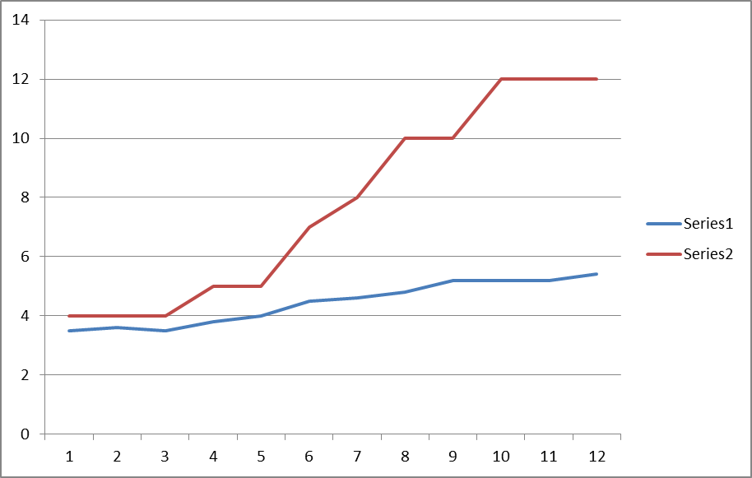
Series 1: Average direct patient care for 6 RT’s Series 2: Average pt. by adding groups and changing hours.

Slide 38
Employee tracking
Notes:
Group tracking of productivity. Dips represent the two periods of time when one employee brought productivity down; left on a month leave; productivity improved; returned and had the productivity demonstrated, employee quit, morale went back up and surpassed standrs.

Slide 39
The difficult decisions…….
Difficult therapist
Limited budget; supply costs/space
Promotion of discipline and program
Productivity
Labor costs
Notes:
10% personality
How to support the budget with quality not necessarily quantity
How to improve productivity for direct care of the patient vs. the development of an intervention/program
REMEMBER YOU ARE MAKING THE BIG BUCKS
****Basically how do you keep the therapy and still have the promotion/fun/joy of the event
How to

Slide 40
Beyond the Checklist
All participants in a real team need to know how to do and how to think about their individual tasks. But they also need to think about how their tasks, knowledge of their tasks, and knowledge of the changing context in which those tasks are performed affect the activities of those with whom they are working. Gordon and Mendenhall

Slide 41
Core Competencies required for recreational therapists
Demonstrated and documented skills training within practice
Equipment: van, evacuation equip
Groups; content, management, outcomes
Culture/Diversity/Age
Patient safety/community

Slide 42
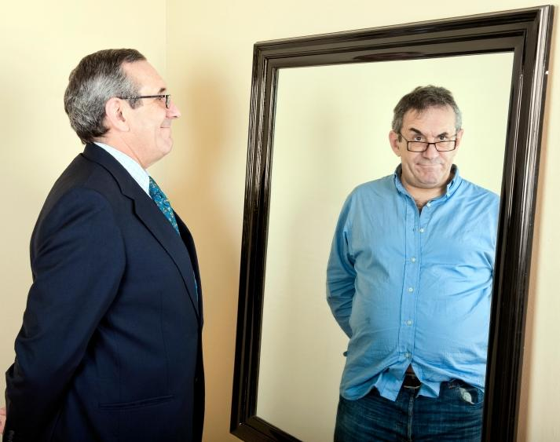
What am I accountable for? How do I demonstrate my reliability? Do I Role Model Responsibility?
“If you want to know why people are not performing well,
Step up to the mirror and take a peek” Ken Blanchard

